Slide 1
Feature Toggle
Kalpna Prakash

Slide 2
About Me
Around 15 years of rich technical experience
Senior Technical Architect with Pitney Bowes
Extensive experience in Software Architecture, Design, Development and Performance Optimization
Lectures in several forums and universities including Delhi University
Presented papers at several local and global conferences.
Gold Medalist in Electronics (Graduate) and Computer Applications(Post Graduate) Courses both from Delhi University

Slide 3
AGENDA
What is Feature Toggle ?
Why we need Feature Toggle ?
Types
Frameworks
How to implement ?
Demonstration
Key Considerations
Lessons Learnt
Variants in Industry

Slide 4
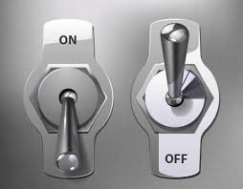
What is Feature Toggle
Technique in software development that attempts to provide an alternative to maintaining multiple source-code branches.

Slide 5
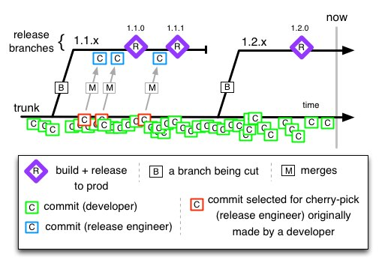
Why we need Feature Toggle
CI/CD: Avoid Branches and Merges
Image courtesy: http://paulhammant.com/2013/04/05/what-is-trunk-based-development/

Slide 6
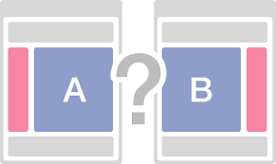
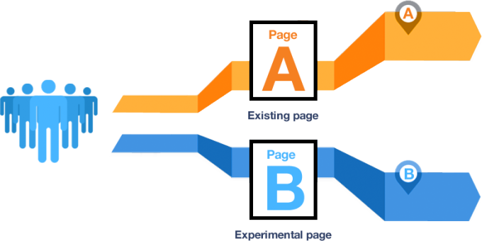
Why we need Feature Toggle
A/B Testing
Image Courtesy: http://www.mazeberry.com/en/blog-ab-testing-is-it-a-good-idea/

Slide 7


Why we need Feature Toggle
Unfinished Code in production
Image courtesy: http://mission17.org/exhibits/unfinished/index.htm/

Slide 8


Why we need Feature Toggle
Reducing risk associated with large change
Image courtesy: http://csrc.nist.gov/organizations/fissea/2015-conference/presentations/march-24/fissea-2015-toner.pdf/

Slide 9

Why we need Feature Toggle
Turning a resources heavy feature OFF in high load conditions
Image courtesy: http://www.mxmindia.com/2013/07/will-the-ad-switch-off-get-broadcasters-to-revert-to-weekly-ratings

Slide 10
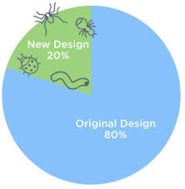
Why we need Feature Toggle
Phased rollout
Image courtesy: https://blog.optimizely.com/2014/11/11/5-ways-phased-rollouts-will-protect-your-ios-app/

Slide 11

Why we need Feature Toggle
Safe To Fail
Image courtesy: http://www.neatorama.com/2010/03/10/how-bomb-proof-suits-work/

Slide 12
Types of Toggles
Release Toggles
Business Toggles
Deployment Toggles (Ops Toggles)
Experiment Toggles (Canary cohort)

Slide 13
Static vs Dynamic
Business
Toggles
Deployment
Toggles
Experiment
Toggles
Release Toggles
Configurability ---→

Slide 14
Long-lived vs Transient
Business
Toggles
Longevity---→
Deployment
Toggles
Experiment
Toggles
Release Toggles

Slide 15
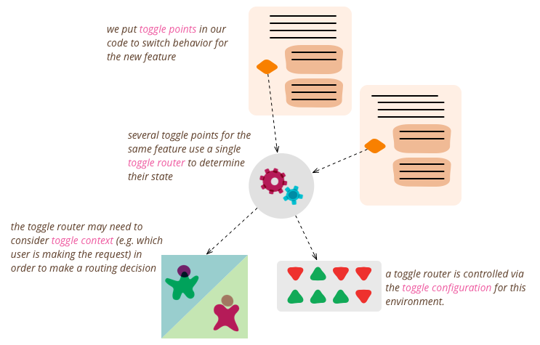
Baseline Architecture
Image courtesy: http://martinfowler.com/articles/feature-toggles.html#

Slide 16
Design Patterns
Parallel change Pattern
Strategy Pattern
Factory Pattern
Chain of Responsibility Pattern

Slide 17
Frameworks Available
Ruby
Flip
Rollout
Degrade
PHP
FeatureToggle (Symfony)
Python
Gargoyle (Django)
Django Waffle (Django)
Nexus admin
JavaScript:
FeatureFlipperJS (Node)
.Net:
FeatureToggle
Groovy
GrailsFeatureToggle
Java
Togglz

Slide 18
Demonstration
Import greeting message from a template file and wish the admin of the organization. The message may vary and can be changed. We also need to expose this greeting to the world so that some one else may use it.

Slide 19
Steps in development –spanning several sprints
Import greeting message with hardcoded admin name
Allow greeting message to be editable
Allow the Admin name to be changed in database and read from there
Allow the API to be exposed to be used as a service

Slide 20
Important to recognize
When to use Feature Toggle?
Phased RollOut
A/B Testing or Selective Turn on
Dark Launch
Deployment feature configuration
When NOT to use?
BUG Fixes
Internal Builds
Demos to Product Owners

Slide 21
Life Cycle of a Toggle
CREATE
READ
UPDATE
DELETE

Slide 22
Not Removing Toggles!!!
Software will be harder to improve, maintain, test and deploy.
Loose control of toggles
Chaos!!!
Biggest Tech Debt

Slide 23

Excessive use of toggles
Overcomplicated
Unmaintainable
Buggy
Quick hacks and fixes
Untested
Poor Quality

Slide 24

Lessons Learnt!!!
Image courtesy: http://www.directindustry.com

Slide 25
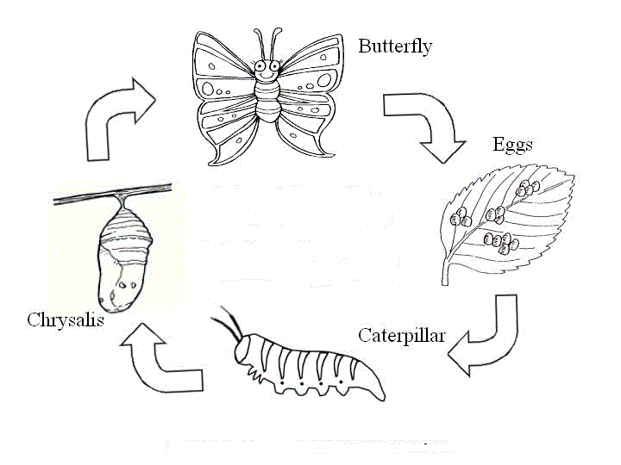
Lessons Learnt!!!
Image courtesy: http://www3.canisius.edu/~grandem/butterflylifecycle/The_Lifecycle_of_a_Butterfly_print.html

Slide 26
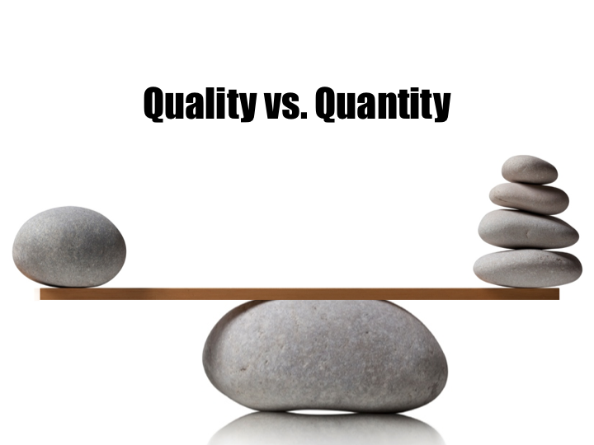
Lessons Learnt!!!
Image courtesy: http://www.ajbubb.com/the-struggle-between-quantity-and-quality/#

Slide 27

Lessons Learnt!!!

Slide 28

Lessons Learnt!!!
Image courtesy: http://beforeitsnews.com/alternative/2013/12/the-right-name-makes-a-difference-2856136.html

Slide 29
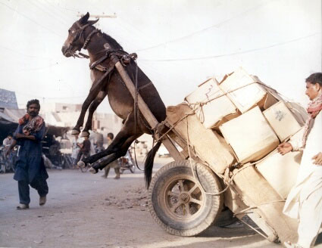
Lessons Learnt!!!
Image courtesy: https://www.flickr.com

Slide 30

Lessons Learnt!!!
Image courtesy: https://www.customisedesigns.co.uk

Slide 31




Latent Code Variants

Slide 32


Slide 33
References
Martin Fowler – Feature Toggle
https://en.wikipedia.org/wiki/Feature_toggle
http://www.paulhammond.org/2009/06/velocity/10deploys.pdf
http://www.beautifulbuilds.com/feature-toggle-frameworks-list/
Feature Flipping for Java

Slide 34

kalpna.gulati@pb.com
kalpna.gulati@gmail.com
https://in.linkedin.com/in/kalpna-prakash-1505576

